Slide 1
Department of Electronics & Communication
Title of the Project:
IOT BASED SOIL MOISTURE MONITORING

Slide 2

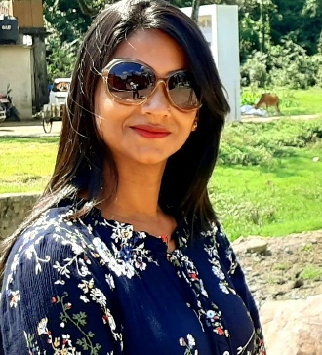

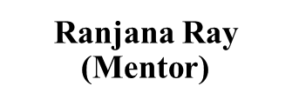

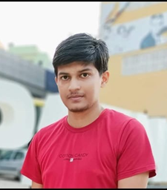
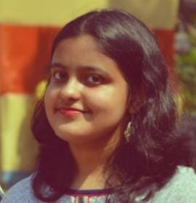
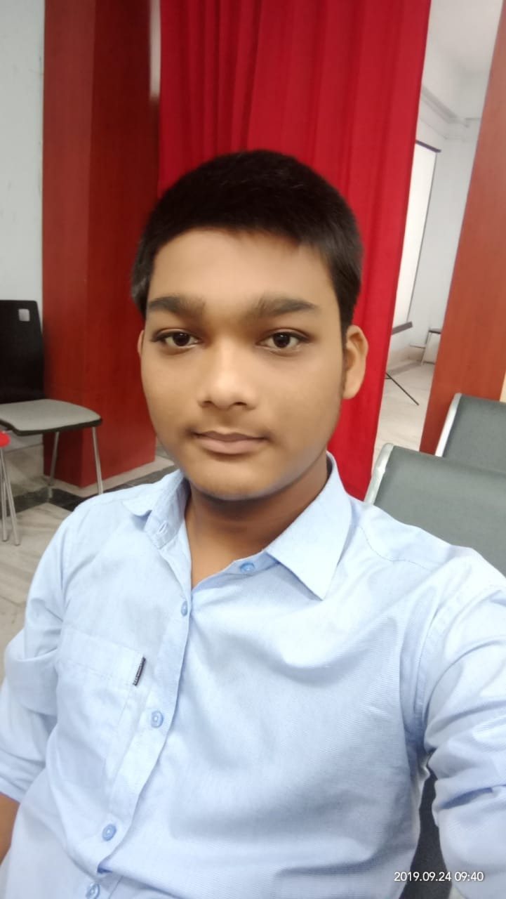
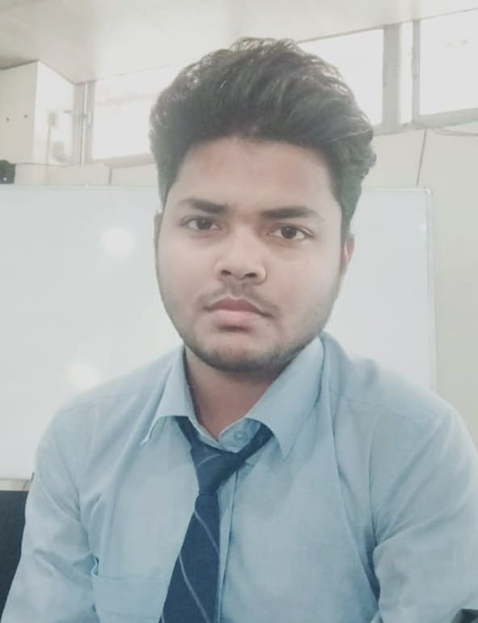
Team Members & Mentors
Dipanjan Mondal
Arpan Sen
Javed Ansari
Ayush Rohan
Amrita Bhattacharjee
Dhairya Mohan Jha

Slide 3
Team Contact:
Sl. No | Name of the Students /Innovator | University Roll No | College ID | Mobile no | Mail Id
1 | Amrita Bhattacharjee | 123190802005 | JIS/2019/0106 | 7596855900 | bhattacharjeeamrita19@gmail.com
2 | Arpan Sen | 123190802010 | JIS/2019/0242 | 9748054706 | arpansen131@gmail.com
3 | Ayush Rohan | 123190802016 | JIS/2019/0366 | 7765096301 | ayushrohan5@gmail.com
4 | Dipanjan Mondal | 123190802023 | JIS/2019/0239 | 7586948375 | dipanjanmondal03032000@gmail.com
5 | Dhairya Mohan Jha | 123190802022 | JIS/2019/0458 | 9939155255 | dhairyamohanjha@gmail.com
6 | Javed Ansari | 123190802030 | JIS/2019/0561 | 82940 93811 | mailto:Javed02212@gmail.com

Slide 4
Problem Statement:
Automation refers to the use IoT to control appliances by
using computer technology. Computer Systems enables
from remote control of lighting through to complex
micro-controller or computer based networks with various
degrees of intelligence and automation. IoT
provides security, energy efficiency and ease of use hence,
it is adopted more. It also provides remote interface to
home appliances to provide control and monitoring on a
web browser, which is what we have tried to achieve in this project. Our project fouses on the use of IoT technologies to facilitate soil moisture monitoring at any time, from anywhere in the world.

Slide 5
Soil moisture information plays an important role in environmental monitoring, agricultural production and hydrological studies. Particularly, agricultural yield depends on several growing parameters like temperature, humidity, soil moisture and pH of the soil, etc. In this project, we have designed and developed a system for measuring and monitoring soil moisture by interfacing low-cost soil moisture sensor with ESP8266, using ThingSpeak Internet of Things (IoT) and Cloud computing. The system was tested under laboratory conditions. The device is designed to record the real-time data using Cloud technology so that any person can observe the data anywhere-anytime and can react quickly based on the soil moisture.
Project Abstract:

Slide 6
Idea towards Problem Solution
In this project, we are going to interface a Resistive Soil moisture sensor HW-080 with NodeMCU ESP8266 Board. This sensor measures the volumetric content of water inside the soil and gives us the moisture level as output. The sensor is equipped with both analog and digital output, so it can be used in both analog and digital modes. Here we will use the sensor in Analog mode and measure the soil moisture in percentage.
The measured soil moisture can be sent to any IoT cloud platform. In this case, we will use Thingspeak Server. Thin speak server is an open data platform and API for the Internet of Things that enables you to collect, store, analyze, visualize, and act on data from sensors. The soil moisture data from Soil Moisture Sensor can be monitored online from any part of the world.

Slide 7
Novelty/uniqueness of the Idea
It helps to monitor soil moisture in real time.
It is less expensive and has good accuracy in medium to find soils due to their fine-sized particle.
It is less time-consuming and more feasible.
Using this method simultaneous measurement of soil moisture at different depths for the same location is possible.

Slide 8
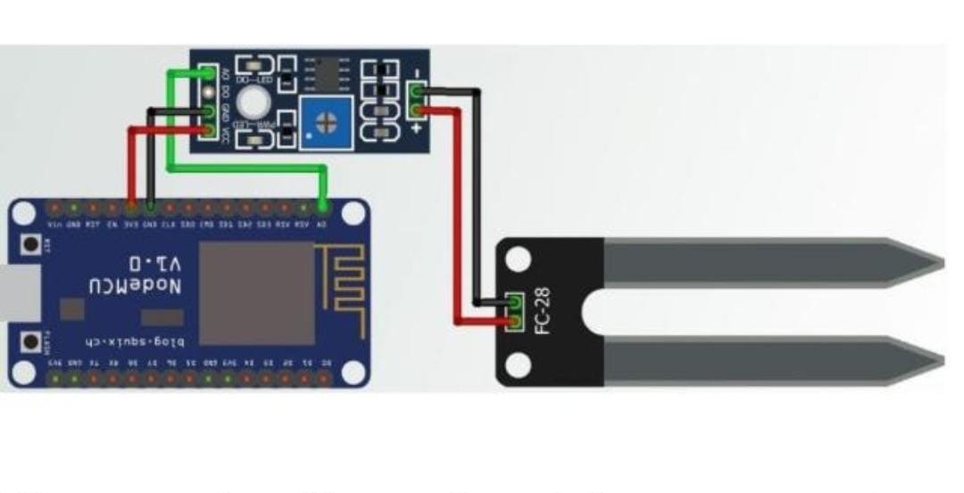
Block Diagram or Processes Flow Diagram or Circuit Diagram Related to Project :

Slide 9
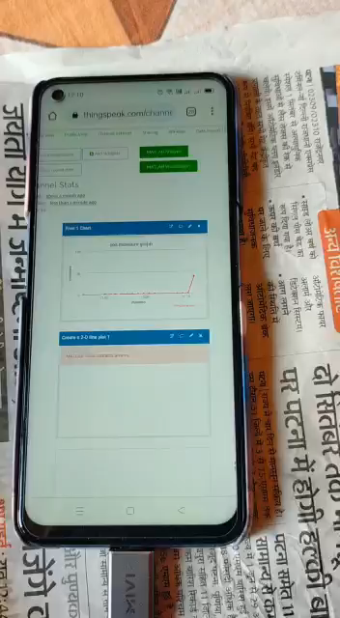
1/2 min video/animation to support your Idea:

Slide 10
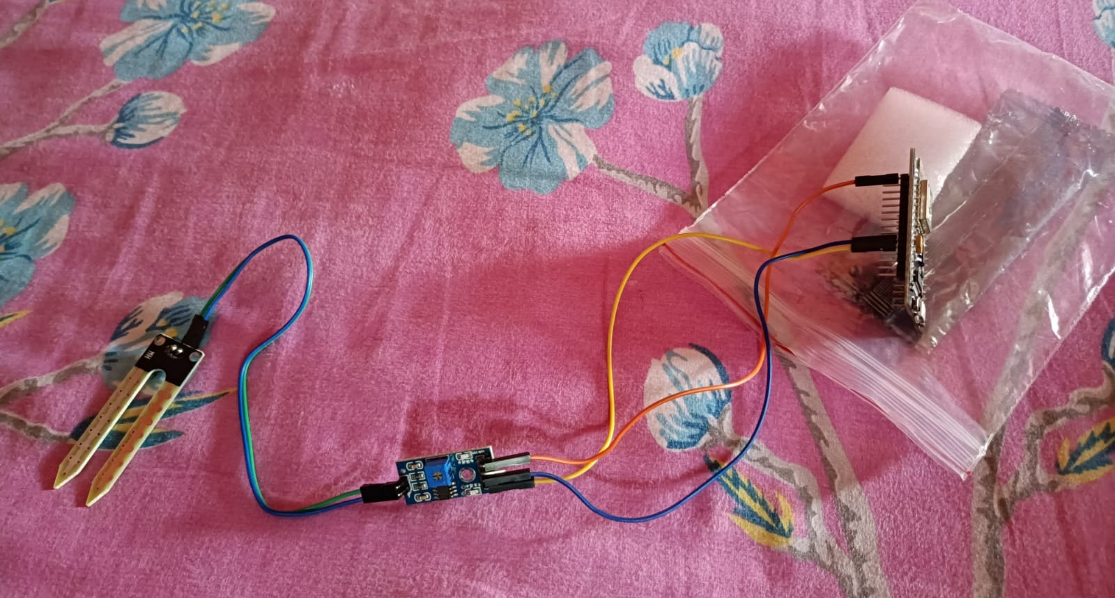
Image of Product/System Developed till Date :

Slide 11
Outcome of the Project & Social Impact
Monitor Data-The primary and main advantage of this project is monitoring.
Ease of Access-Anytime one can easily gain the required information in real-time, from (almost) any location they are at. Speedy Operation.
Better Time Management.
Automation and Control.
Data Breach.
Improved productivity of staff and reduced human labor.
Efficient operation management.
Better use of resources and assets.
Cost-effective operation.
Improved work safety.
Thorough marketing and business development.
Improved customer service and retention.
Better business opportunities.

Slide 12
Price Involved in Developing a Single Unit :
SL.No. | Items | Quantity | Rs. | Justification
1 | Node mcu ESP8266 | 1 | 275 rs | https://play.google.com/store/apps/details?id=com.electronicscomp.app
2 | Soil moisture sensor | 1 | 58 rs | https://play.google.com/store/apps/details?id=com.electronicscomp.app
3 | Jumper wires 5 unit | 1 | 45 rs | https://play.google.com/store/apps/details?id=com.electronicscomp.app
Total |  |  | 378 rs

Slide 13
Feasibility of Project in terms of prototype, product Development and Business application.
Attributes | Score (0-10)
Prototype | 4
Product Development | 7
Business Application | N/A

Slide 14
Future Scope
The expansion of mobile platform to iOS (iPhone operating System) as most of the systems is not supporting android application because of not getting full platform support from hardware board.
A user can understand the module perfectly for this a speech-to-text module can be integrated so that the user can interact verbally.
A voice recognition system could be added as a new feature.
As security is the most essential element of any module so for that purpose a low-cost camera can be added for the feature of face recognition which can improve the security.
A sensor like heartbeat sensor could be added to this system which may help in checking the heartbeat of the patient in case of an emergency and would serve a great deal.
Improvement in the lifestyle of a user can be suggested through the implementation of machine learning algorithms which would track sleep patterns and activity of the user etc.
Future IOT sensors must have enhanced security to prevent cyber-attacks which can be prevented by implementing number of security features in IOT sensor hardware and stack and by adding more layers of security which include private keys, number generators etc. which would keep the attackers away from breaching the network.
Features such as power monitoring of appliances and temperature control could be added.
The inclusion of GUI interface could create more attraction of the project

Slide 15
Thank You

